Slide 1

DAY 03
Chapters 7 & 8 Arrays & Searching arrays

Slide 2
Array - Memory Layout
The definition:
int tests[5];
allocates the following memory:
first element
second element
third element
fourth element
fifth element

Slide 3
Array Terminology
In the definition int tests[5];
int is the data type of the array elements
tests is the name of the array
5, in [5], is the size declarator. It shows the number of elements in the array.
The size of an array is (number of elements) * (size of each element)

Slide 4
Size Declarators
Named constants are commonly used as size declarators.
const int SIZE = 5; int tests[SIZE];

Slide 5
Accessing Array Elements
The last element’s subscript is n-1 where n is the number of elements in the array.
subscripts:
0
1
2
3
4

Slide 6
Accessing Array Elements
Array elements can be used as regular variables:
tests[0] = 79; cout << tests[0];
cin >> tests[1];
tests[4] = tests[0] + tests[1];
Arrays must be accessed via individual elements:
cout << tests; // not legal

Slide 7
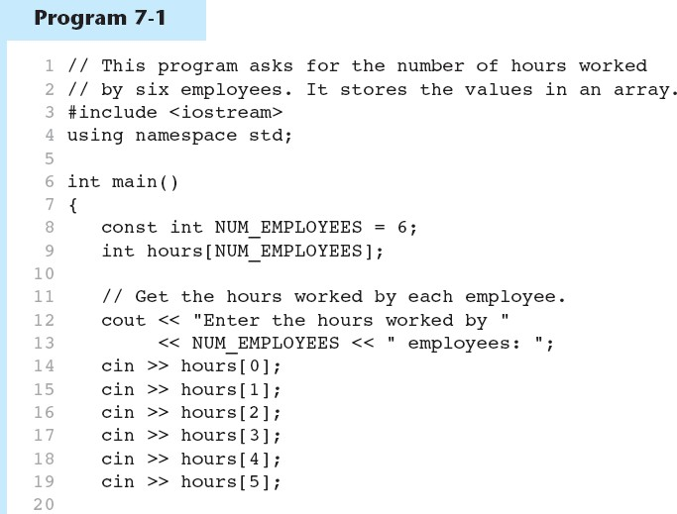
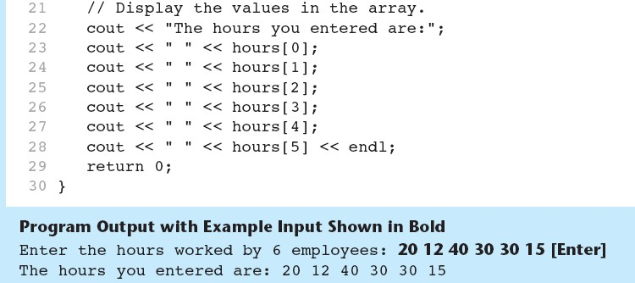
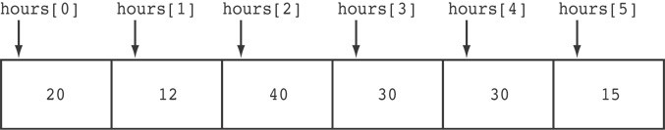

Slide 8
Using a Loop to Step Through an Array
const int ARRAY_SIZE = 5; int numbers[ARRAY_SIZE];
for (int count = 0; count < ARRAY_SIZE; count++) numbers[count] = 99;

Slide 9
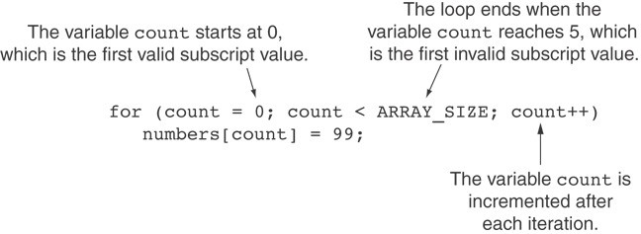
A Closer Look At the Loop

Slide 10
Array Initialization
Arrays can be initialized with an initialization list:
const int SIZE = 5;
int tests[SIZE] = {79,82,91,77,84};
The values are stored in the array in the order in which they appear in the list.
The initialization list cannot exceed the array size.

Slide 11
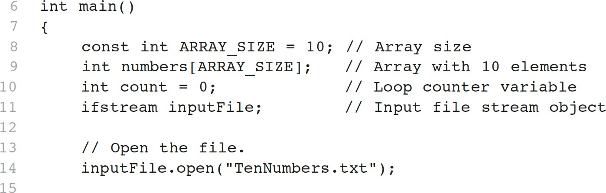
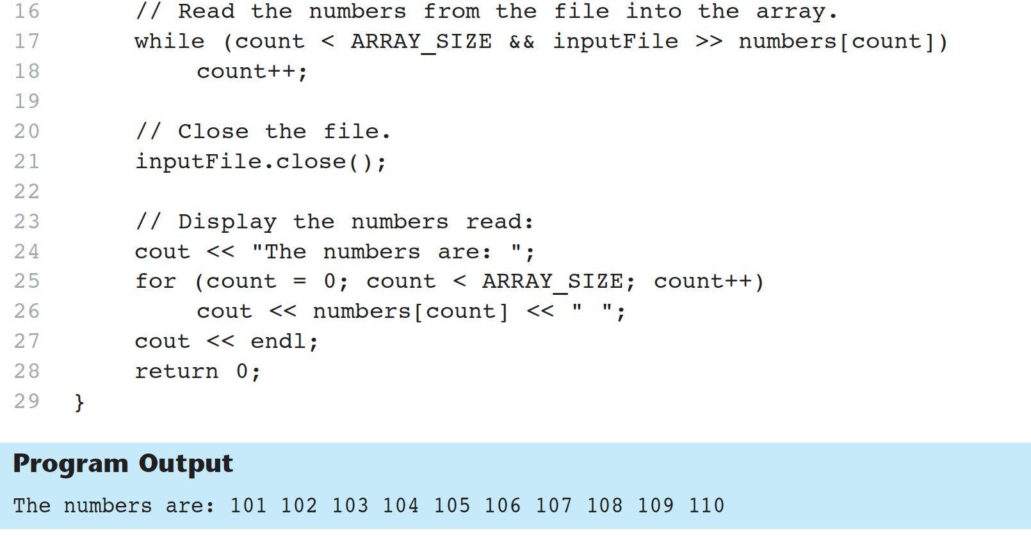
Code From Program 7-3

Slide 12
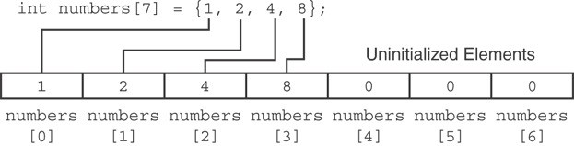
Partial Array Initialization
If array is initialized with fewer initial values than the size declarator, the remaining elements will be set to 0:

Slide 13
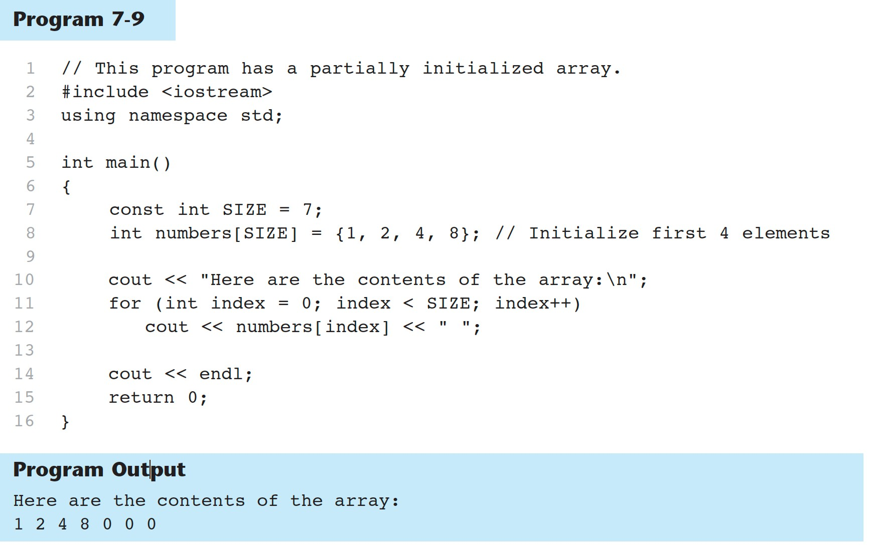

Slide 14
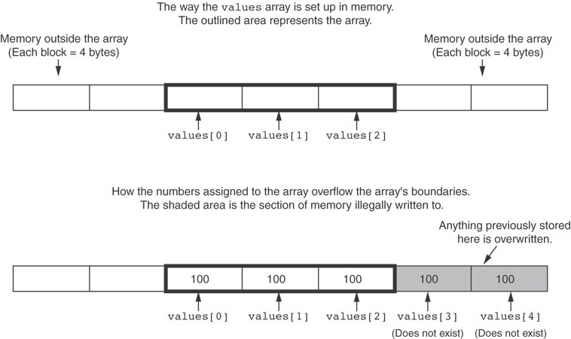
What the Code Does

Slide 15
The Range-Based for Loop
Here is the general format of the range-based for loop:
for (dataType rangeVariable : array) statement;
dataType is the data type of the range variable.
rangeVariable is the name of the range variable. This variable will receive the value of a d array element during each loop iteration.
array is the name of an array on which you wish the loop to operate.
statement is a statement that executes during a loop iteration. If you need to execute more t statement in the loop, enclose the statements in a set of braces.

Slide 16
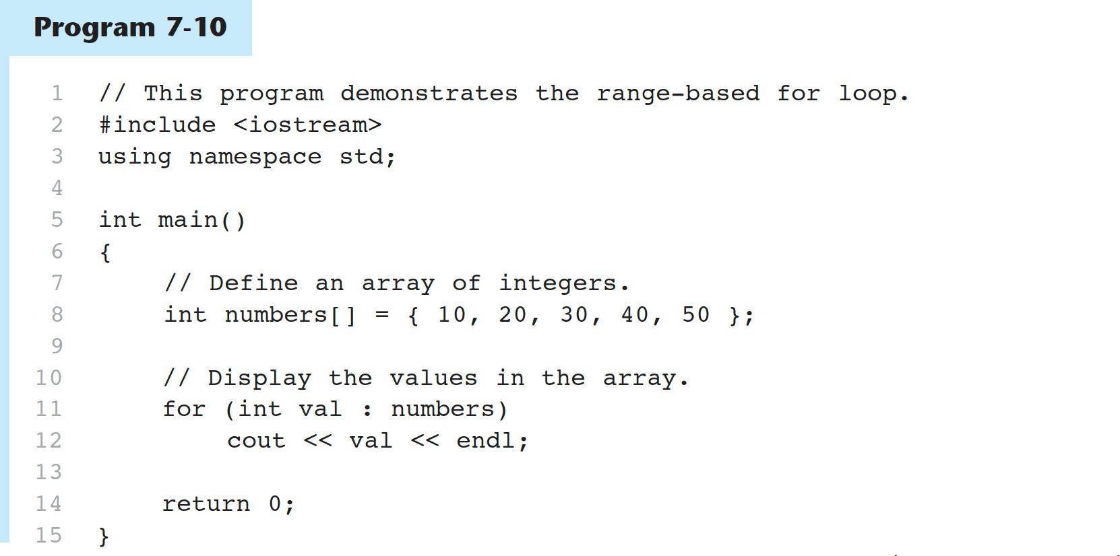
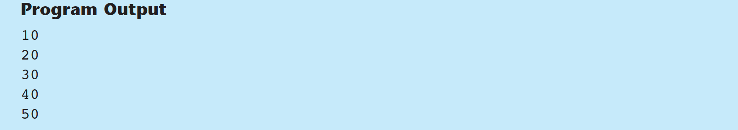

Slide 17
Modifying an Array with a Range-Based for Loop in Program 7-12
const int SIZE = 5; int numbers[5];
// Get values for the array. for (int &val : numbers)
{
cout << "Enter an integer value: "; cin >> val;
}
// Display the values in the array.
cout << "Here are the values you entered:\n"; for (int val : numbers)
cout << val << endl;

Slide 18
You can use the auto key word with a reference range variable. For example, the code in lines 12 through 16 in Program 7-12 could have been written like this:
Modifying an Array with a Range-Based for Loop
for (auto &val : numbers)
{
cout << "Enter an integer value: "; cin >> val;
}

Slide 19
Processing Array Contents
Array elements can be treated as ordinary variables of the same type as the array
When using ++, -- operators, don’t confuse the element with the subscript:
tests[i]++; // add 1 to tests[i] tests[i++]; // increment i, no
// effect on tests

Slide 20
Array Assignment
To copy one array to another,
Don’t try to assign one array to the other:
newTests = tests; // Won't work
Instead, assign element-by-element:
for (i = 0; i < ARRAY_SIZE; i++)
newTests[i] = tests[i];

Slide 21
Printing the Contents of an Array
You can display the contents of a character array by sending its name to cout:
char fName[] = "Henry";
cout << fName << endl;
For other types of arrays, you must print element-by-element:
for (i = 0; i < ARRAY_SIZE; i++)
cout << tests[i] << endl;

Slide 22
Finding the Highest Value in an Array
int count; int highest;
highest = numbers[0];
for (count = 1; count < SIZE; count++)
{
if (numbers[count] > highest) highest = numbers[count];
}
When this code is finished, the highest variable will contain the highest value in the numbers array.

Slide 23
Finding the Lowest Value in an Array
int count; int lowest;
lowest = numbers[0];
for (count = 1; count < SIZE; count++)
{
if (numbers[count] < lowest) lowest = numbers[count];
}
When this code is finished, the lowest variable will contains the lowest value in the numbers array.

Slide 24
Comparing Arrays
To compare two arrays, you must compare element-by- element:
const int SIZE = 5;
int firstArray[SIZE] = { 5, 10, 15, 20, 25 };
int secondArray[SIZE] = { 5, 10, 15, 20, 25 }; bool arraysEqual = true; // Flag variable
int count = 0; // Loop counter variable
// Compare the two arrays.
while (arraysEqual && count < SIZE)
{
if (firstArray[count] != secondArray[count]) arraysEqual = false;
count++;
}
if (arraysEqual)
cout << "The arrays are equal.\n"; else
cout << "The arrays are not equal.\n";

Slide 25
Using Parallel Arrays
Parallel arrays: two or more arrays that contain related data
A subscript is used to relate arrays: elements at same subscript are related
Arrays may be of different types

Slide 26
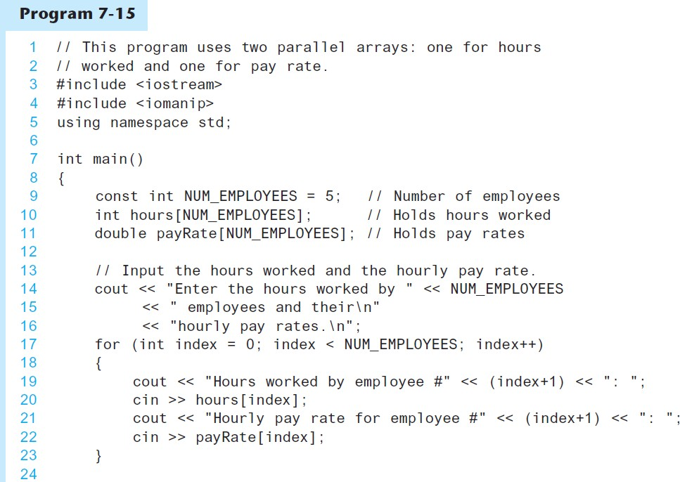
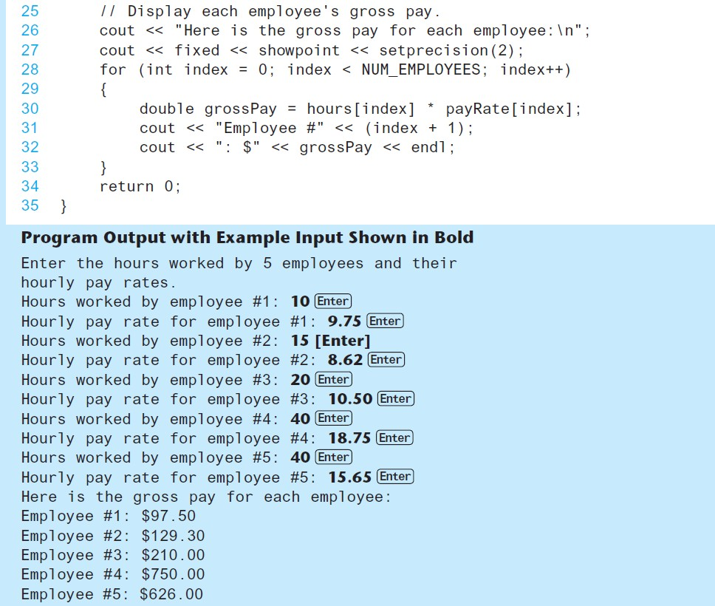
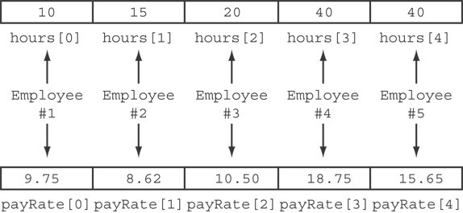

Slide 27
Arrays as Function Arguments
To define a function that takes an array parameter, use empty [] for array argument:
// function prototype void showScores(int []);
// function header
void showScores(int tests[])

Slide 28
Arrays as Function Arguments
When passing an array to a function, it is common to pass array size so that function knows how many elements to process:
showScores(tests, ARRAY_SIZE);
Array size must also be reflected in prototype, header:
// function prototype
void showScores(int [], int);
// function header
void showScores(int tests[], int size)
29

Slide 29
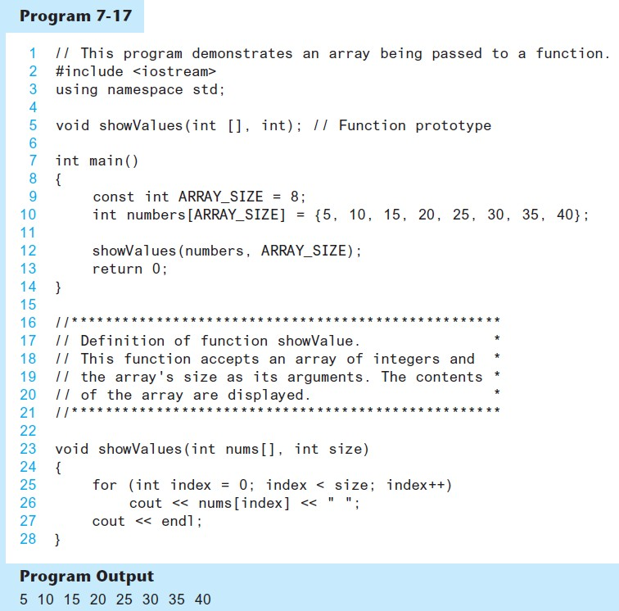
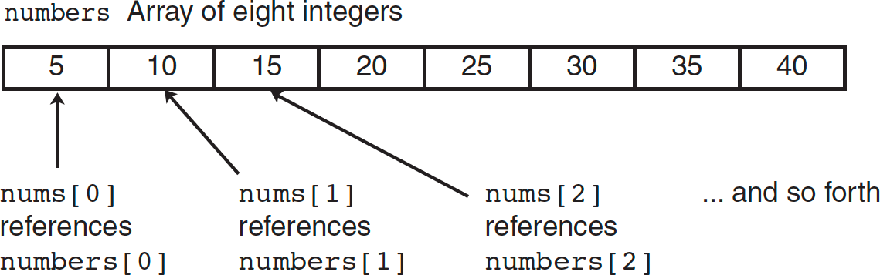
Passing an Array to a Function in Program 7-17

Slide 30
Two-Dimensional Arrays
Can define one array for multiple sets of data
Like a table in a spreadsheet
Use two size declarators in definition:
const int ROWS = 4, COLS = 3; int exams[ROWS][COLS];

Slide 31
const int ROWS = 4, COLS = 3; int exams[ROWS][COLS];
Two-Dimensional Array Representation
columns
exams[0][0] | exams[0][1] | exams[0][2]
exams[1][0] | exams[1][1] | exams[1][2]
exams[2][0] | exams[2][1] | exams[2][2]
exams[3][0] | exams[3][1] | exams[3][2]
r o w s
Use two subscripts to access element:
exams[2][2] = 86;

Slide 32
2D Array Initialization
Two-dimensional arrays are initialized row-by-row:
const int ROWS = 2, COLS = 2;
int exams[ROWS][COLS] = { {84, 78},
{92, 97} };
84 | 78
92 | 97
Can omit inner { }, some initial values in a row – array elements without initial values will be set to 0 or NULL

Slide 33
Two-Dimensional Array as Parameter, Argument
Use array name as argument in function call:
getExams(exams, 2);
Use empty [] for row, size declarator for column in prototype, header:
const int COLS = 2;
// Prototype
void getExams(int [][COLS], int);
// Header
void getExams(int exams[][COLS], int rows)

Slide 34
Chapters 8 Searching and Sortig arrays

Slide 35
Linear Search
Also called the sequential search
Starting at the first element, this algorithm sequentially steps through an array examining each element until it locates the value it is searching for.

Slide 36
Linear Search - Example
Array numlist contains:
17 | 23 | 5 | 11 | 2 | 29 | 3
Searching for the the value 11, linear search examines
17, 23, 5, and 11
Searching for the the value 7, linear search examines
17, 23, 5, 11, 2, 29, and 3

Slide 37
Linear Search
Algorithm:
set found to false; set position to –1; set index to 0 while index < number of elts. and found is false
if list[index] is equal to search value
found = true position = index
end if
add 1 to index end while
return position

Slide 38
A Linear Search Function
int linearSearch(int arr[], int size, int value)
{
int index = 0; int position = -1; bool found = false; | // // // | Used as a subscript to search the array To record the position of search value Flag to indicate if value was found
while (index < size { | && | !found)
if (arr[index] == value) // If the value is found
{
found = true; // Set the flag
position = index; // Record the value's subscript
}
index++; // Go to the next element
}
return position; // Return the position, or -1
}

Slide 39
Linear Search - Tradeoffs
Benefits:
Easy algorithm to understand
Array can be in any order
Disadvantages:
Inefficient (slow): for array of N elements, examines N/2 elements on average for value in array, N elements for value not in array

Slide 40
Requires array elements to be in order
Binary Search
Divides the array into three sections:
middle element
elements on one side of the middle element
elements on the other side of the middle element
If the middle element is the correct value, done. Otherwise, go to step 1. using only the half of the array that may contain the correct value.
Continue steps 1. and 2. until either the value is found or there are no more elements to examine

Slide 41
Binary Search - Example
Array numlist2 contains:
2 | 3 | 5 | 11 | 17 | 23 | 29
Searching for the the value 11, binary search examines 11 and stops
Searching for the the value 7, linear search examines 11, 3, 5, and stops

Slide 42
Binary Search
Set first to 0
Set last to the last subscript in the array Set found to false
Set position to -1
While found is not true and first is less than or equal to last
Set middle to the subscript half-way between array[first] and array[last]. If array[middle] equals the desired value
Set found to true
Set position to middle
Else If array[middle] is greater than the desired value Set last to middle - 1
Else
Set first to middle + 1 End If.
End While. Return position.

Slide 43
A Binary Search Function
int binarySearch(int array[], int size, int value)
{
int first = 0,
last = size - 1, middle,
position = -1;
bool found = false;
// First array element
// Last array element
// Mid point of search
// Position of search value
// Flag
while (!found && first <= last)
{
middle = (first + last) / 2; if (array[middle] == value)
{
found = true; position = middle;
}
else if (array[middle] > value) last = middle - 1;
else
first = middle + 1;
}
return position;
// Calculate mid point
// If value is found at mid
// If value is in lower half
// If value is in upper half
}

Slide 44
Binary Search - Tradeoffs
Benefits:
Much more efficient than linear search. For array of N elements, performs at most log₂N comparisons
Disadvantages:
Requires that array elements be sorted

Slide 45
Introduction to Sorting Algorithms
Sort: arrange values into an order:
Alphabetical
Ascending numeric
Descending numeric
Two algorithms considered here:
Bubble sort
Selection sort

Slide 46
Concept:
Bubble Sort
Compare 1st two elements
- If out of order, exchange them to put in order
Move down one element, compare 2nd and 3rd elements, exchange if necessary. Continue until end of array.
Pass through array again, exchanging as necessary
Repeat until pass made with no exchanges

Slide 47
Example – First Pass
Array numlist3 contains:
17 | 23 | 5 | 11
compare values
17 and 23 – in correct order, so no exchange
compare values 23 and 5 – not in correct order, so exchange them
compare values 23 and 11 – not in correct order, so exchange them

Slide 48
Example – Second Pass
After first pass, array numlist3 contains:
17 | 5 | 11 | 23
compare values 17 and 5 – not in correct order, so exchange them
compare values 17 and 11 – not in correct order, so exchange them
compare values 17 and 23 – in correct order, so no exchange

Slide 49
Example – Third Pass
After second pass, array numlist3 contains:
5 | 11 | 17 | 23
compare values 5 and 11 – in correct order, so no exchange
compare values 11 and 17 – in correct order, so no exchange
compare values 17 and 23 – in correct order, so no exchange
No exchanges, so array is in order

Slide 50
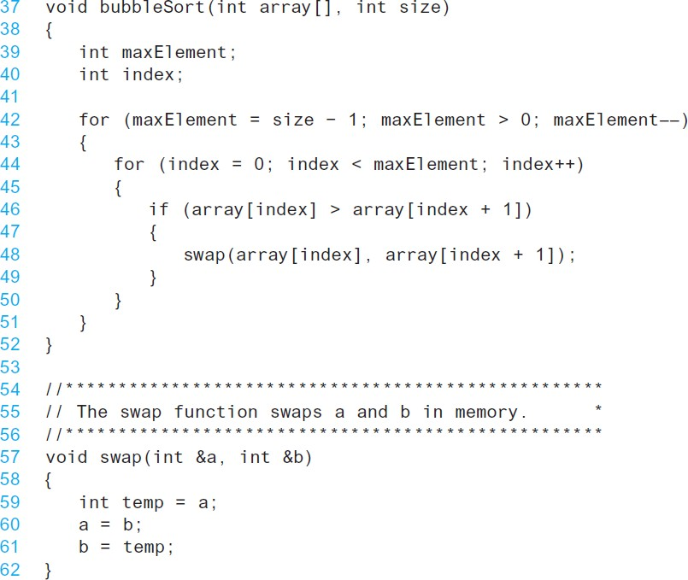
From Program 8-4
A Bubble Sort Function –

Slide 51
Bubble Sort - Tradeoffs
Benefit:
Easy to understand and implement
Disadvantage:
Inefficient: slow for large arrays

Slide 52
Selection Sort
Concept for sort in ascending order:
Locate smallest element in array. Exchange it with element in position 0
Locate next smallest element in array. Exchange it with element in position 1.
Continue until all elements are arranged in order

Slide 53
Selection Sort - Example
Array numlist contains:
11 | 2 | 29 | 3
1. Smallest element is 2. Exchange 2 with element in 1st position in array:
2 | 11 | 29 | 3

Slide 54
Example (Continued)
2. Next smallest element is 3. Exchange 3 with element in 2nd position in array:
2 | 3 | 29 | 11
3. Next smallest element is 11. Exchange 11 with element in 3rd position in array:
2 | 3 | 11 | 29

Slide 55
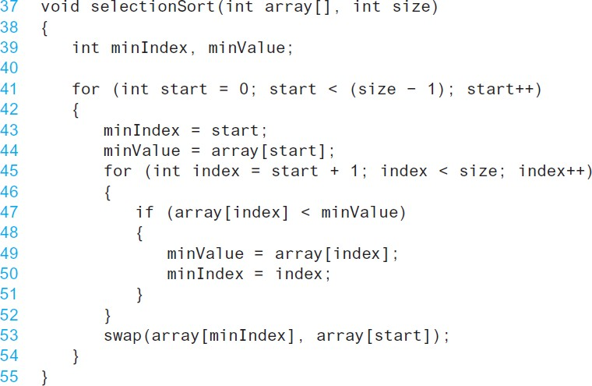
From Program 8-5
A Selection Sort Function –

Slide 56
Selection Sort - Tradeoffs
Benefit:
More efficient than Bubble Sort, since fewer exchanges
Disadvantage:
May not be as easy as Bubble Sort to understand

Slide 57
8.5
Sorting and Searching Vectors

Slide 58
Sorting and Searching Vectors
Sorting and searching algorithms can be applied to vectors as well as arrays
Need slight modifications to functions to use vector arguments:
vector <type> & used in prototype
No need to indicate vector size – functions can use size member function to calculate

